Slide 1

Reducing Goal State Divergence With Environment Design
KELSEY SIKES Advisor: Dr. Sarath Sreedharan Committee: Dr. Edwin K.P. Chong, Dr. Nathaniel Blanchard

Slide 2

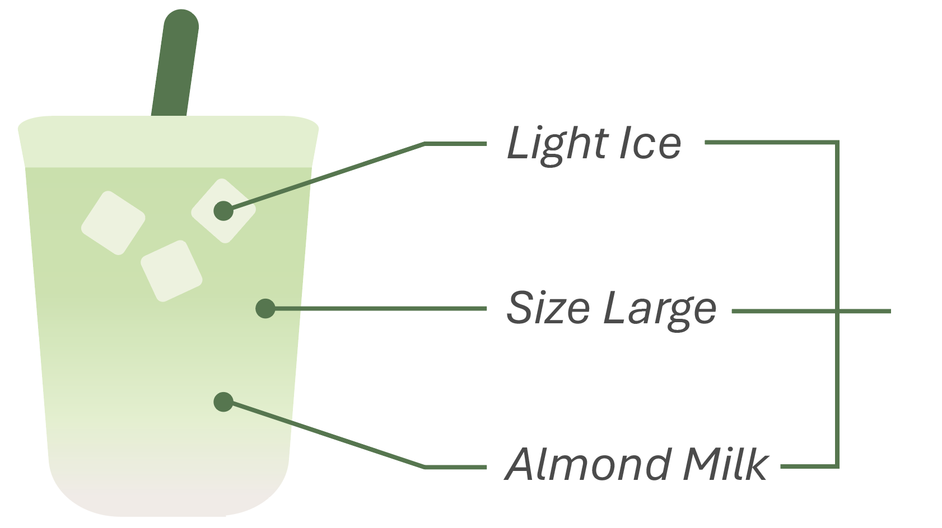
Solving the Misalignment Problem
Human-Robot collaborations on the rise
GOAL SPECIFICATION
HUMAN GOAL: “Matcha Latte, please.”
HUMAN EXPECTATIONS: “Matcha Latte with XYZ, please.”
1

Slide 3

Solving the Misalignment Problem
Issues can arise when a human’s expectations differ from a robot’s current state/capabilities
HUMAN EXPECTED GOAL: Matcha Latte
ROBOT ACHIEVED GOAL: Vanilla Latte
2

Slide 4
Solving the Misalignment Problem
What happens when the potential goal states a human expects a robot to achieve, differ from those it might achieve?
GOAL STATE DIVERGENCE
ENVIRONMENT DESIGN
3

Slide 5
Our Roadmap
What is Classical Planning?
A Greenhouse Disaster
An Introduction to Goal State Divergence
HRGAD Problem + Algorithm That Solves It
Our Results & Evaluation
4

Slide 6

Classical Planning
Planning problems are represented using a Model
This captures “how the world works” & consists of three things:
Domain, Initial State, Goal
5

Slide 7
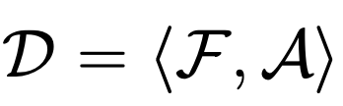






Classical Planning
Domain: The environment the robot is operating in, shown by
corresponds to a set of fluents (propositional, boolean state variables), where
corresponds to a set of actions, where
6

Slide 8
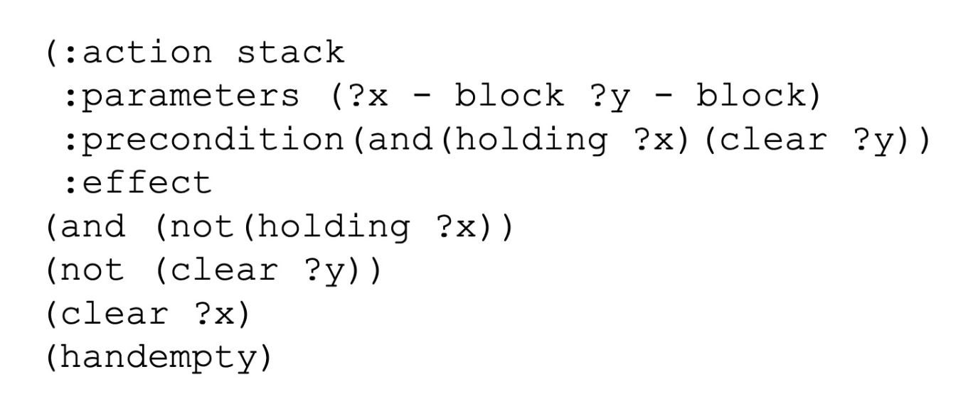

Classical Planning
Domain: The environment the robot is operating in, shown by
Blocksworld IPC Domain - Stack Action
7

Slide 9
Classical Planning
Domain: The environment the robot is operating in, shown by
Blocksworld IPC Domain - Stack Action
7

Slide 10
Classical Planning
Domain: The environment the robot is operating in, shown by
Blocksworld IPC Domain - Stack Action
7

Slide 11
Classical Planning
Domain: The environment the robot is operating in, shown by
Blocksworld IPC Domain - Stack Action
7

Slide 12






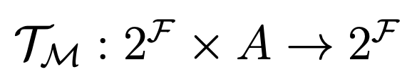
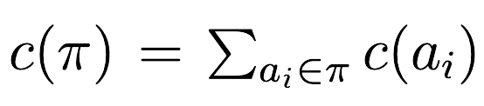
Classical Planning
Initial State: Initial configuration of the world, shown by
Goal: The objective to be achieved, shown by
Accomplished by executing a plan:
A transition function is used to progress from one action to the next:
Each action in this plan has a cost; summing these reveals the cost of the plan:
,
(set of plans:
,
)
8

Slide 13
Planning Domain Definition Language
PDDL is the standard language for representing classical planning problems using a:
Domain File: describes setting robot is operating in with fluents & actions
Problem File: objects, initial state and a robot goal specification
We input these into a planner, a program which generates a sequence of actions to move a robot from an initial state to a goal state
Domain File: describes setting robot is operating in with fluents & actions
Problem File: objects, initial state and a robot goal specification
Model
Blocksworld IPC Domain - Stack Action
9

Slide 14




Model ( )
HUMAN’S MODEL
ROBOT’S MODEL
What the human believes the robot’s current state/capabilities are.
What the robot’s actual state/capabilities are.
10

Slide 15
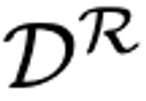
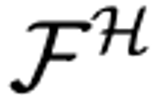



Model ( )
HUMAN’S MODEL
ROBOT’S MODEL
What the human believes the robot’s current state/capabilities are.
What the robot’s actual state/capabilities are.
10

Slide 16
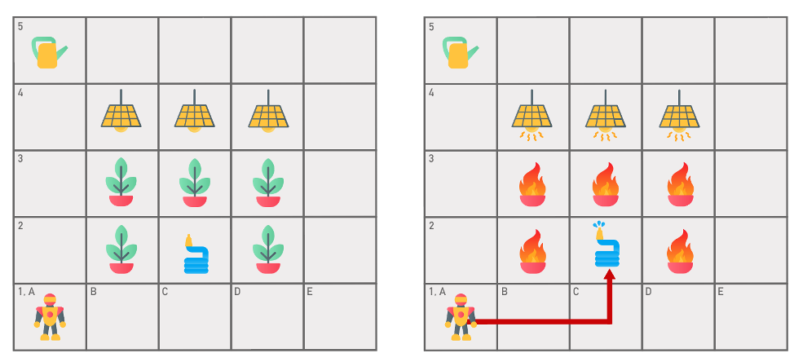
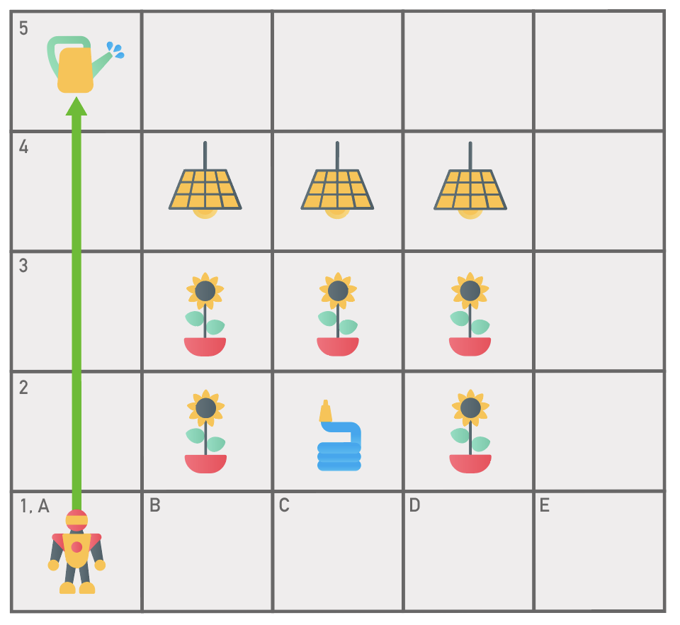
A Greenhouse Disaster ☹
Initial State
Expected Final Goal State
HUMAN’S MODEL
Move
Pick up / Put Down
Use Watering Pail
Human Goal: “Water the greenhouse plants.”
11

Slide 17
A Greenhouse Disaster ☹
HUMAN’S MODEL
Initial State
Achieved Final Goal State
Move
Pick up / Put Down
Use Watering Pail
ROBOT’S MODEL
Move
Pick up / Put Down
Use Watering Pail
Use Hose
Human Goal: “Water the greenhouse plants.”
12

Slide 18
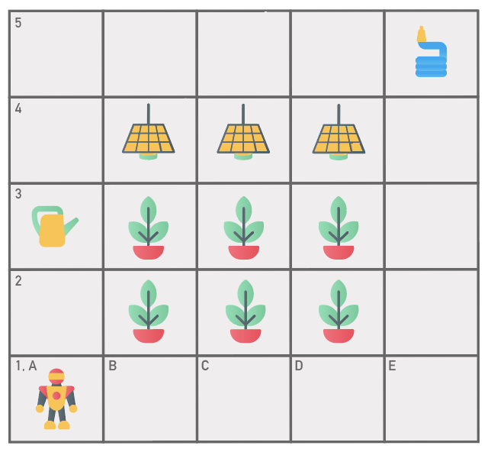
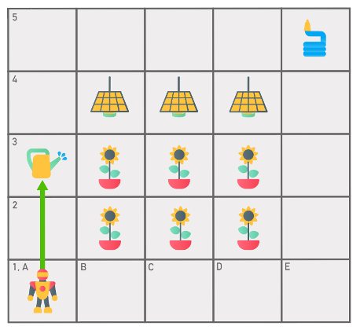
A Greenhouse Success ☺
Initial State
Achieved Final Goal State
DESIGN CHANGES
Hose Placement
Protective Heat Lamp Covers
Watering Pail Placement
Human Goal: “Water the greenhouse plants.”
13

Slide 19

How Do We Achieve This?
We need a measure of what’s close and what’s not
Then we need to optimize for this metric
❌
14

Slide 20
Goal State Divergence
DEFINITION
OBJECTIVES
A metric which quantifies the difference between the final goal state a human expected and the one a robot achieved.
Goal Achieved
Final goal state closely aligned with human expectations
Assumptions:
1
Access to Human’s Model
2
Human-Robot Share Same Fluents/Goal
15

Slide 21
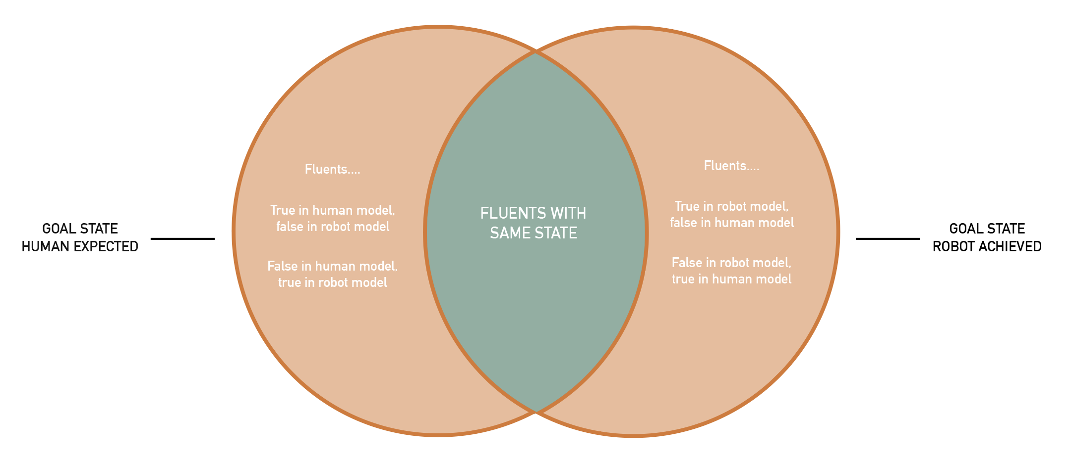
Calculating Goal State Divergence
Goal State Divergence measures the difference between the human/robot’s final goal state fluents
16

Slide 22
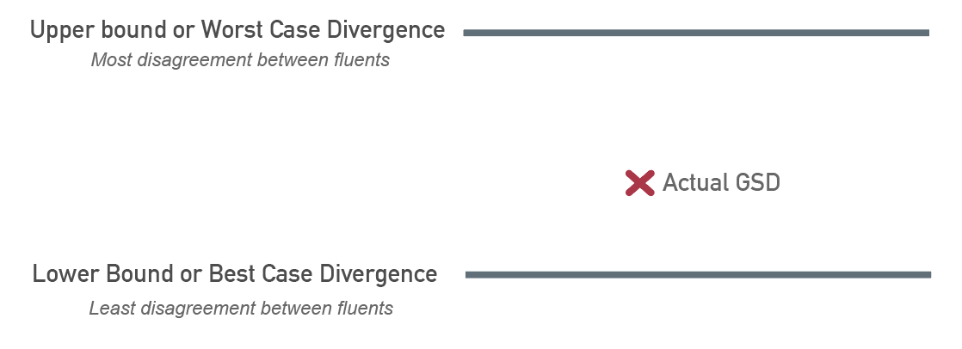
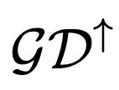
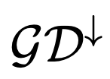
Approximating Goal State Divergence
Assumption: A loose upper bound where the space of all plans is considered
17

Slide 23
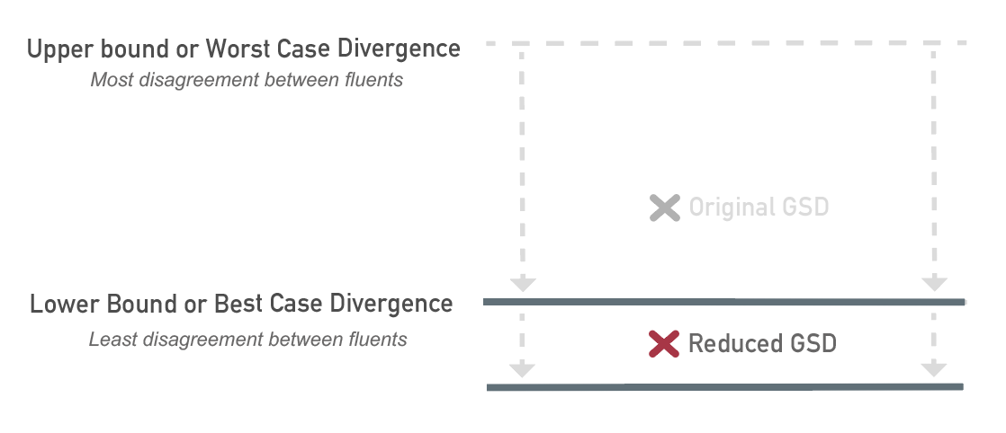
Design for Reducing Goal State Divergence
18

Slide 24
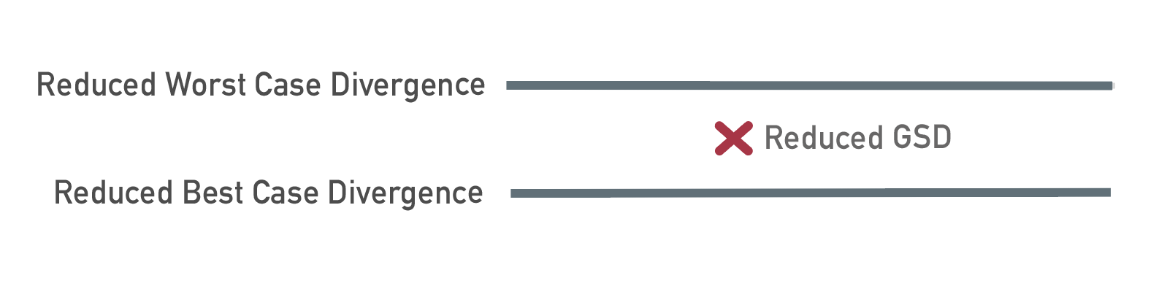
Design for Reducing Goal State Divergence
19

Slide 25
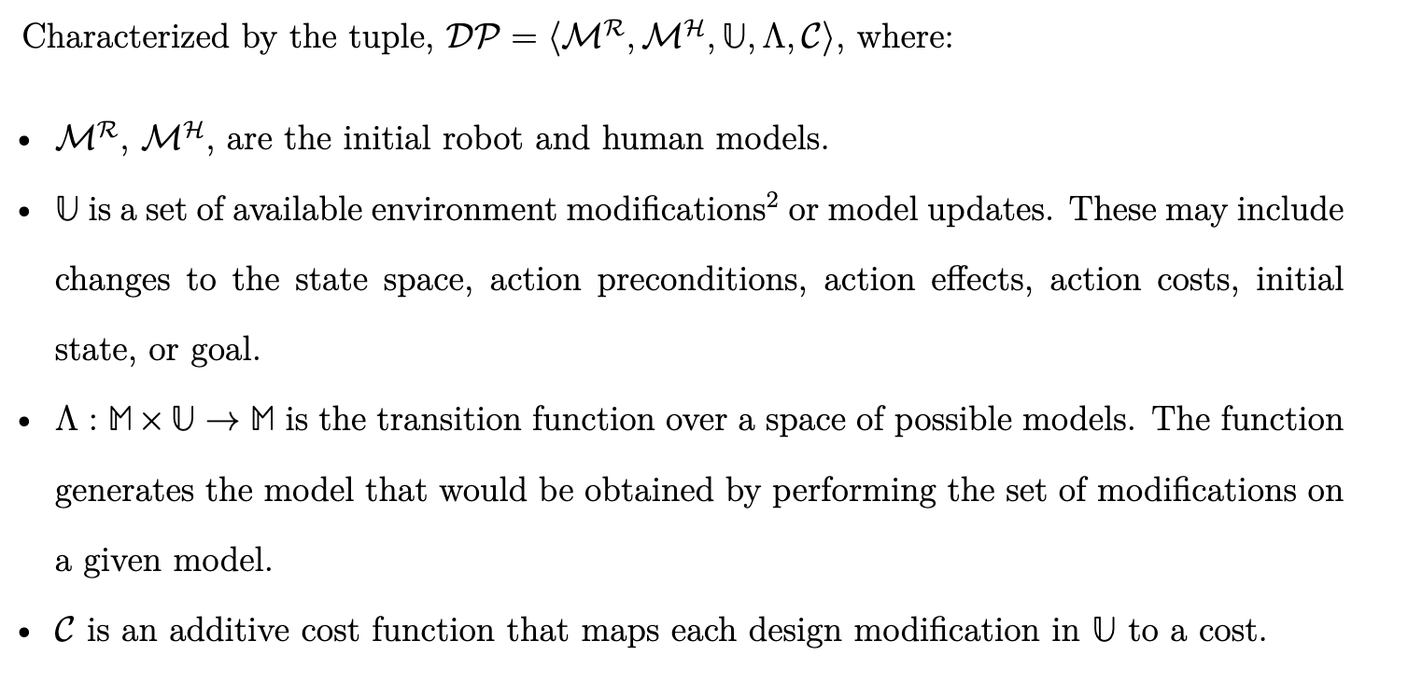
Human-Robot Goal Alignment Design Problem (HRGAD)
Assumption: All design modifications are independent & can therefore be made in any order
20

Slide 26
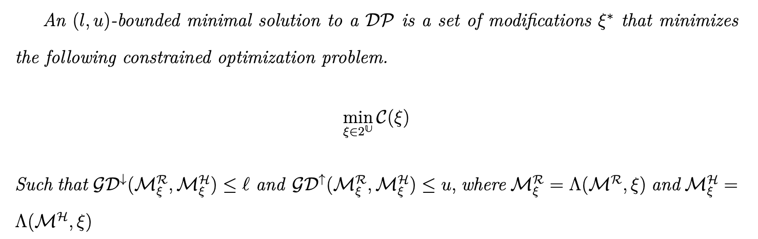
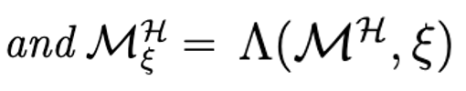
HRGAD Design Problem Cost Minimization
21

Slide 27
How Do We Solve an HRGAD Problem?
Compile human-robot models into single planning problem
Generate human-robot plans for the specified goal
Each set of actions will operate on a different copy of the state fluents
Have human-robot achieve goal using identified plans
Compare human-robot final goal states using a set of compare actions
Note: To get the upper/lower bound, we will penalize the planner based on the behavior we want
22

Slide 28
Model Compilation
Human Model:
Robot Model:
23

Slide 29



Model Compilation
Model Pair: Human + Robot Models
New Compiled Model
Domain: Extended Sets of Fluents & Actions
24

Slide 30


Model Compilation
Domain: Extended Sets of Fluents & Actions
Compiled Fluents
25

Slide 31
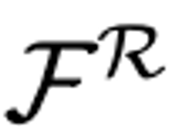


Model Compilation
Domain: Extended Sets of Fluents & Actions
Compiled Fluents
Original Robot Fluents:
Human Copy Fluents:
Exact copy of Robot’s fluents
26

Slide 32






Model Compilation
Domain: Extended Sets of Fluents & Actions
Compiled Fluents
Robot Housekeeping Fluent
Human Housekeeping Fluent
PURPOSE:
More efficient compilation
Preserve final goal states for comparison
27

Slide 33

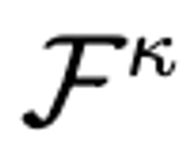
Model Compilation
Domain: Extended Sets of Fluents & Actions
Compiled Fluents
Compare Fluents:
?
==
)
contains a compare fluent for every fluent in the robot’s model (i.e.
for every
28

Slide 34



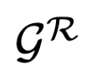

Model Compilation
Initial State
Goal
Robot Goal:
Human Goal:
Compare ALL Human-Robot Fluent Pairs Goal:
?
==
29

Slide 35









Model Compilation
Domain: Extended Sets of Fluents & Actions
Compiled Actions
Robot Actions:
Human Actions:
Exact copy of robot’s actions
30

Slide 36


Model Compilation
Domain: Extended Sets of Fluents & Actions
Compiled Actions
Robot Actions:
Human Actions:
Human doesn’t believe robot can execute this action
31

Slide 37


Model Compilation
Domain: Extended Sets of Fluents & Actions
Compiled Actions
Robot Flip Action
Human Flip Action
32

Slide 38
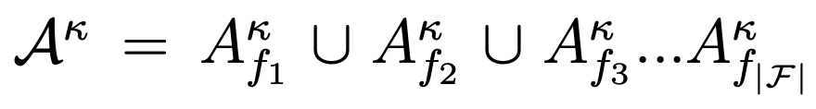
Model Compilation
Domain: Extended Sets of Fluents & Actions
Compiled Actions
Compare Actions: A Set of Sets
33

Slide 39
Model Compilation
Domain: Extended Sets of Fluents & Actions
Compiled Actions
Compare Actions: A Set of Sets
Compare ALL Human-Robot Fluent Pairs Goal:
?
==
34

Slide 40
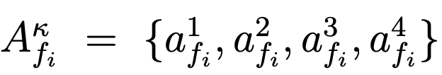
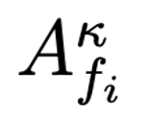
Model Compilation
Domain: Extended Sets of Fluents & Actions
Compiled Actions
Compare Actions: A Set of Sets
4 Actions Per Set
contains a set of compare actions for every fluent in the robot’s model
35

Slide 41







Check Disagreement Actions ( )
1
2
?
?
=
=
Compare Actions: A Set of Sets
4 Actions Per Set
Execute when human-robot fluent pair have different states
36

Slide 42

Check Agreement Actions ( )
3
4
?
?
=
=
Compare Actions: A Set of Sets
4 Actions Per Set
Execute when human-robot fluent pair shares same state
37

Slide 43
So How Are We Finding These Bounds?
We modulate the cost parameters of our check agreement & disagreement actions
This produces different compilation behaviors
38

Slide 44
Finding The Upper Bound ( )
1
2
Zero cost assigned to check disagreement actions
?
?
=
=
3
4
Extremely high cost assigned to check agreement actions
?
?
=
=
Why? We want high disagreement between the human-robot’s final goal states
39

Slide 45
Finding The Lower Bound ( )
1
2
Extremely high cost assigned to check disagreement actions
?
?
=
=
3
4
Zero cost assigned to check agreement actions
?
?
=
=
Why? We want high agreement between the human-robot’s final goal states
40

Slide 46
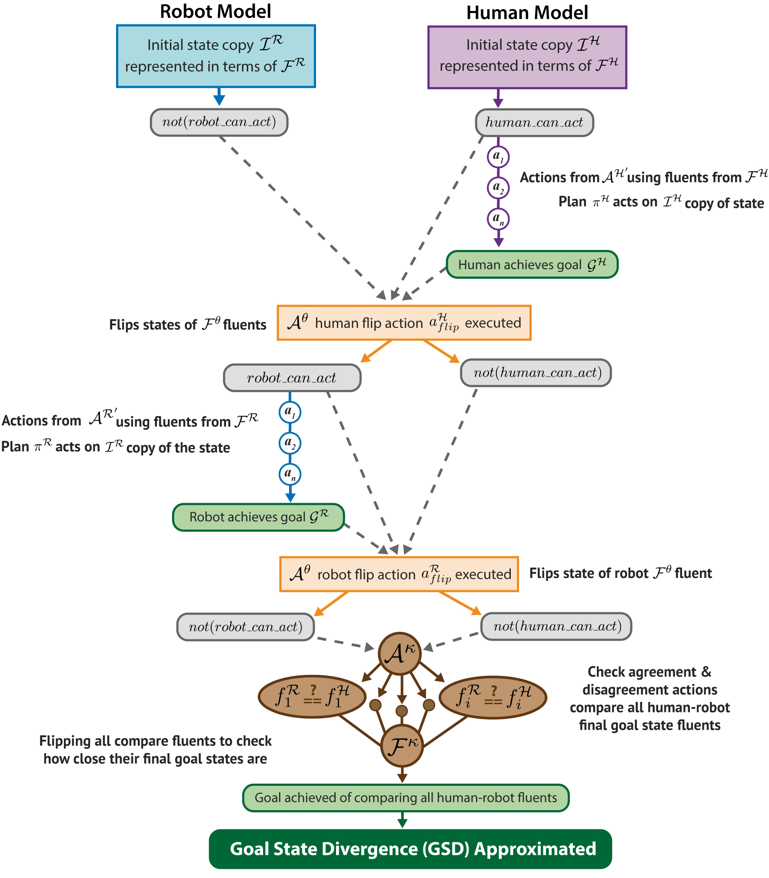
Full GSD Compilation
We combine the human and robot’s models into a single planning problem
Using this compilation we generate human-robot plans for the specified goal
41

Slide 47
Full GSD Compilation
Human starts in state able to act, robot does not
42

Slide 48
Full GSD Compilation
Human starts in state able to act, robot does not
Human executes a plan (performing actions on its copy of the state fluents) and achieves goal
43

Slide 49
Full GSD Compilation
Human starts in state able to act, robot does not
Human executes a plan (performing actions on its copy of the state fluents) and achieves goal
Their ability to perform actions is turned off, the robot’s is turned on
44

Slide 50
Full GSD Compilation
Robot executes a plan (performing actions on its copy of the state fluents) and achieves goal
45

Slide 51
Full GSD Compilation
Robot executes a plan (performing actions on its copy of the state fluents) and achieves goal
Their ability to perform actions is turned off
46

Slide 52
Full GSD Compilation
Robot executes a plan (performing actions on its copy of the state fluents) and achieves goal
Their ability to perform actions is turned off
The human and robot’s final goal state fluents are compared & their Goal State Divergence is approximated
47

Slide 53
Compiling Design into Our Planning Problem
We extend our previously compiled model to identify designs for reducing GSD
We consider a specific instantiation of an HRGAD problem, solved using this Main Algorithm
Designs only made to the initial state
Solving for upper/lower bounds of zero
48

Slide 54

Extended Compiled Model
Compiled Model
New Extended Compiled Model
Extended Compiled Domain
49

Slide 55

Extended Compiled Model
Extended Compiled Domain
Extended Compiled Fluents
50

Slide 56
Extended Compiled Model
Extended Compiled Domain
Extended Compiled Fluents
Robot fluents, human fluents, housekeeping fluents, compare fluents
51

Slide 57
Extended Compiled Model
Extended Compiled Domain
Extended Compiled Fluents
Controls when designs actions can be executed
52

Slide 58
Extended Compiled Model
Extended Compiled Domain
Extended Compiled Fluents
Indicates a design has not been seen or used before and is viable for reducing GSD
53

Slide 59
Extended Compiled Model
Extended Compiled Domain
Extended Compiled Fluents
Fluents used to enforce the design budget
54

Slide 60
Extended Compiled Model
Extended Compiled Domain
Extended Compiled Fluents
Makes sure only one design action per time step can be executed
55

Slide 61
Extended Compiled Model
Extended Compiled Domain
Extended Compiled Fluents
Makes sure design actions of a certain size are implemented
56

Slide 62
Extended Compiled Model
Extended Compiled Domain
Extended Compiled Actions
57

Slide 63
Extended Compiled Model
Extended Compiled Domain
Extended Compiled Actions
Robot actions, human actions, housekeeping actions, compare actions
58

Slide 64
Extended Compiled Model
Extended Compiled Domain
Extended Compiled Actions
The set of available design actions
59

Slide 65
Extended Compiled Model
Extended Compiled Domain
Extended Compiled Actions
Removes all check disagreement actions
Why? We’re looking for perfect alignment between the upper/lower bounds
60

Slide 66



Extended Compiled Model
Extended Compiled Domain
Extended Compiled Actions
3 Purposes:
Ends design phase after all modifications have been made
Deletes
fluent from seen designs
Adds
fluent so planning can resume
61

Slide 67
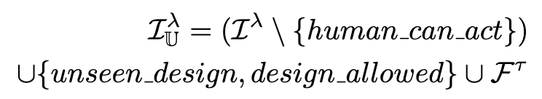
Extended Compiled Model
Extended Compiled Initial State
62

Slide 68
Extended Compiled Model
Extended Compiled Initial State
Robot initial state & human initial state
63

Slide 69

Extended Compiled Model
Extended Compiled Initial State
Ensures designs are viable for reducing Goal State Divergence if the
action didn’t remove this
64

Slide 70
Extended Compiled Model
Extended Compiled Initial State
Indicates that design actions can be performed
65

Slide 71
Extended Compiled Model
Extended Compiled Initial State
Precondition which tracks the design size
66

Slide 72

Extended Compiled Model
Extended Compiled Goal
67

Slide 73
Extended Compiled Model
Extended Compiled Goal
Robot goal, human goal, all final goal state fluents compared
68

Slide 74
Extended Compiled Model
Extended Compiled Goal
All design actions for certain budget implemented
69

Slide 75
Extended Compiled Model
Extended Compiled Goal
All implemented design actions not seen or used before
70

Slide 76


Identifying Minimal Designs for HRGAD
We extended our previously compiled model to identify designs for reducing GSD:
1. DESIGN PHASE
Make design changes to human/robot’s models
Solve for Lower Bound or Best-Case Divergence
2. GOAL ACHIEVEMENT PHASE
Input updated human/robot models into this phase
Solve for Upper Bound or Worst-Case Divergence
71

Slide 77
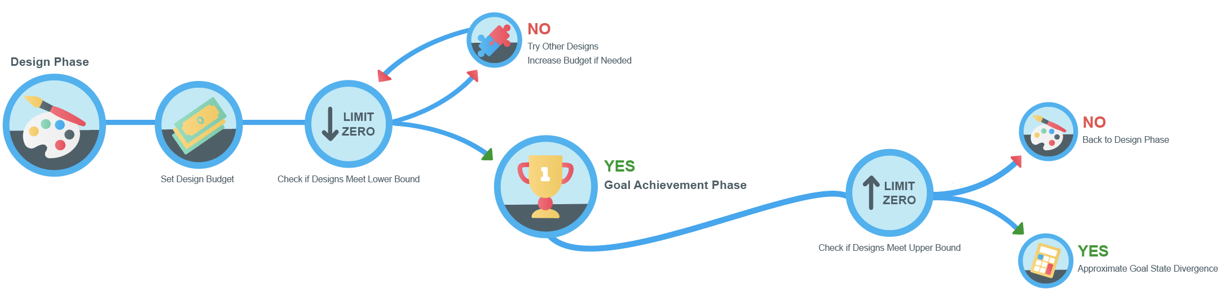
Main Algorithm
72

Slide 78
Main Algorithm
73

Slide 79
Main Algorithm
74

Slide 80
Main Algorithm
75

Slide 81
Main Algorithm
76

Slide 82
Main Algorithm
77

Slide 83
Main Algorithm
78

Slide 84
Main Algorithm
79

Slide 85
Main Algorithm
80

Slide 86
Main Algorithm
81

Slide 87
Main Algorithm
82

Slide 88


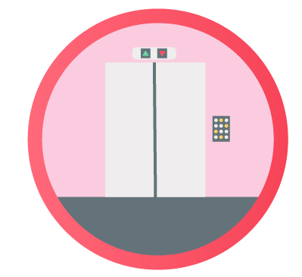
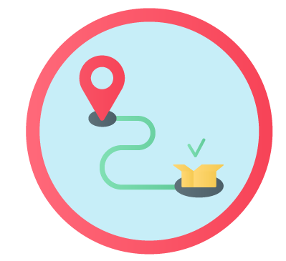

IPC Datasets
125 Problem Instances
Blocksworld
Depot
Elevator
Logistics
Zenotravel
Robot Model: Original problem & domain instance
Human Model: Original problem instance + original domain instance with random initial state fluents removed
83

Slide 89
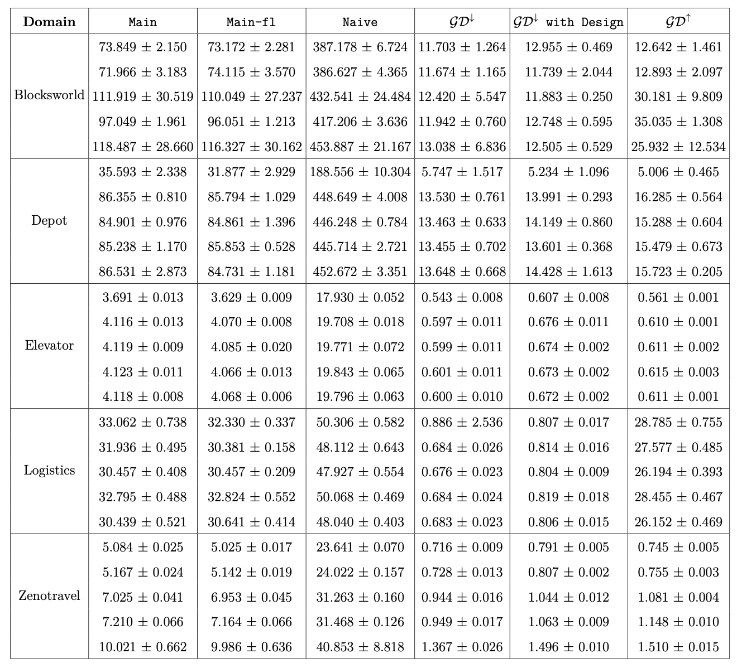
Results
Average & Std. Deviation time (sec)
All values averaged across each domain’s 5 randomly generated problem variations
Solved for max and min goal divergence values of zero
84

Slide 90
Results
Main: Enforced ordering between human/robot actions
Main-fl: No ordering enforced between human/robot actions
Naïve: Iterates over all possible designs (no planning involved)
85

Slide 91
Results
Main: Enforced ordering between human/robot actions
Main-fl: No ordering enforced between human/robot actions
Naïve: Iterates over all possible designs (no planning involved)
86

Slide 92
Results
Main: Enforced ordering between human/robot actions
Main-fl: No ordering enforced between human/robot actions
Naïve: Iterates over all possible designs (no planning involved)
87

Slide 93


Results
Min Divergence ( ): Greatest agreement between fluents
Min Divergence with Design: Design used to find most agreement between fluents
Max Divergence ( ): Least agreement between fluents
88

Slide 94
Results
Min Divergence ( ): Greatest agreement between fluents
Min Divergence with Design: Design used to find most agreement between fluents
Max Divergence ( ): Least agreement between fluents
89

Slide 95
Results
Min Divergence ( ): Greatest agreement between fluents
Min Divergence with Design: Design used to find most agreement between fluents
Max Divergence ( ): Least agreement between fluents
90

Slide 96
Results
Min Divergence ( ): Greatest agreement between fluents
Min Divergence with Design: Design used to find most agreement between fluents
Max Divergence ( ): Least agreement between fluents
91

Slide 97
Results
Min Divergence ( ): Greatest agreement between fluents
Min Divergence with Design: Design used to find most agreement between fluents
Max Divergence ( ): Least agreement between fluents
92

Slide 98
Future Work
Expand the type of design modifications allowed & vary their costs
Don’t always assume changes are independent of each other
Explore more complex decision-making frameworks
93

Slide 99
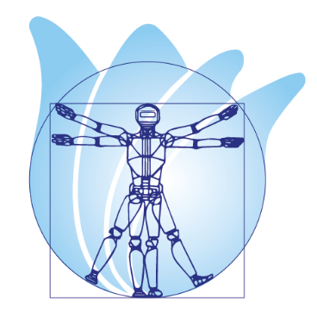


Publications
The 20th Robotics Science & Systems Conference
The 34th International Conference on Automated Planning & Scheduling
International Conference on Intelligent Robots & Systems
Submitted – waiting for decision
Hangzhou, China
Workshop on Task Specification for Intelligent Robots Delft, Netherlands
Workshop on Knowledge Engineering for Planning & Scheduling (KEPS) Banff, Canada
94

Slide 100
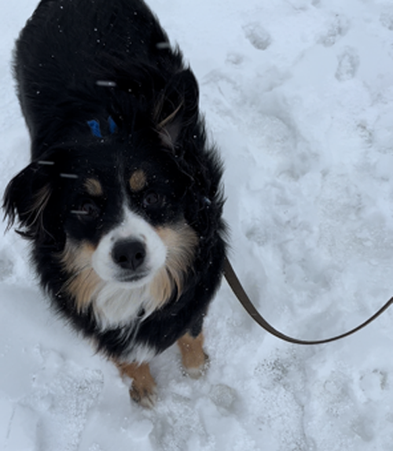
To Dr. Sarath Sreedharan, Dr. Sarah Keren, the HAPI Lab, my committee, family, friends, and everyone who helped make this work possible…
🙏 Thank You!
And the dog…

Slide 101
Conclusion
A first-of-its-kind design framework for aligning a human’s expectations with the final goal state a robot achieves
Questions?
95

Slide 102
Reference Slides

Slide 103
Related Work
1
2
3
4
MODEL RECONCILIATION
EXPLICABLE PLANNING
EXPLICABLE PLANNING
ENVIRONMENT DESIGN
AI SAFETY
A robot performs actions a human would expect while executing its plan
A human and robot’s models are aligned so a desired goal can be better achieved
A robot’s environment is shaped to help it maximize or minimize some objective
A robot is prevented from performing actions leading to a side-effect producing state
2

Slide 104
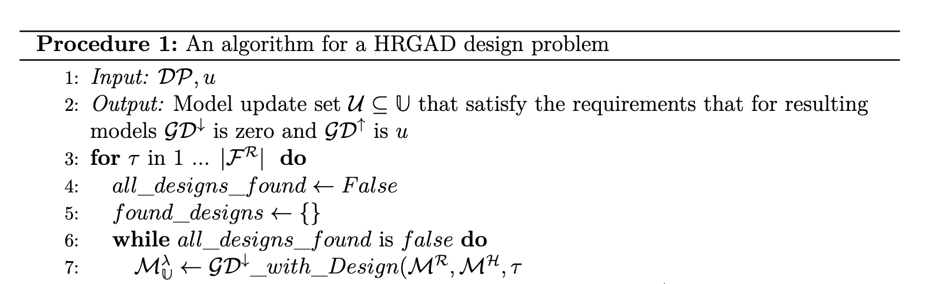

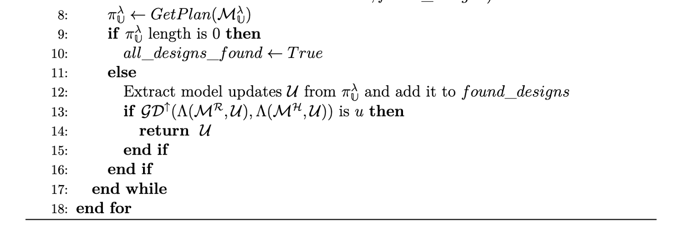
HRGAD Algorithm

Slide 105
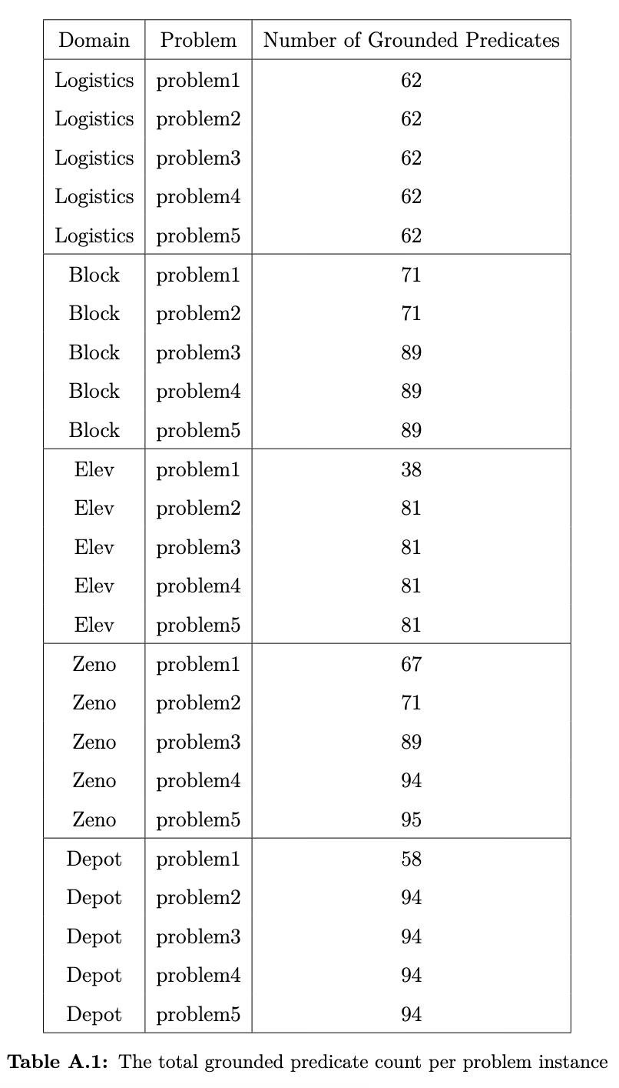
Effect of Problem Size on Time
Performed a reachability analysis to see size of problems in evaluation
Focused on # of grounded predicates:
Planner considered operates over these
Such a count reveals the direct size of the state space

Slide 106
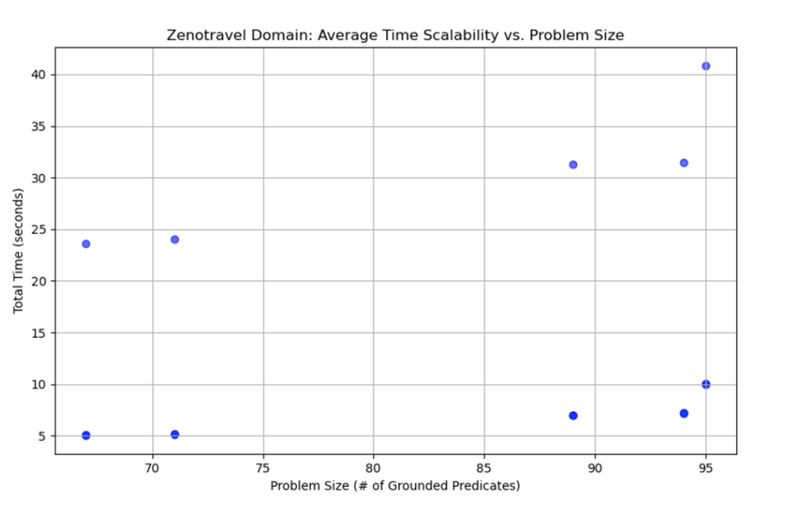
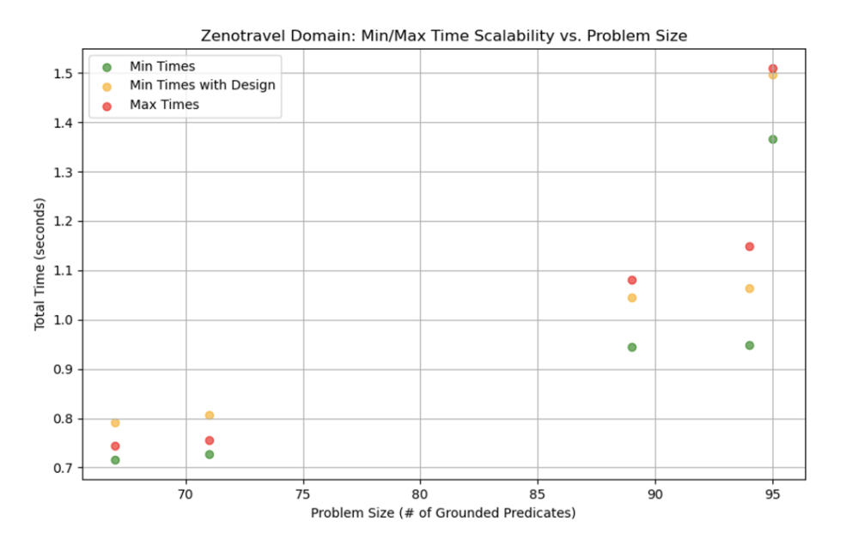
Effect of Problem Size on Time

Slide 107
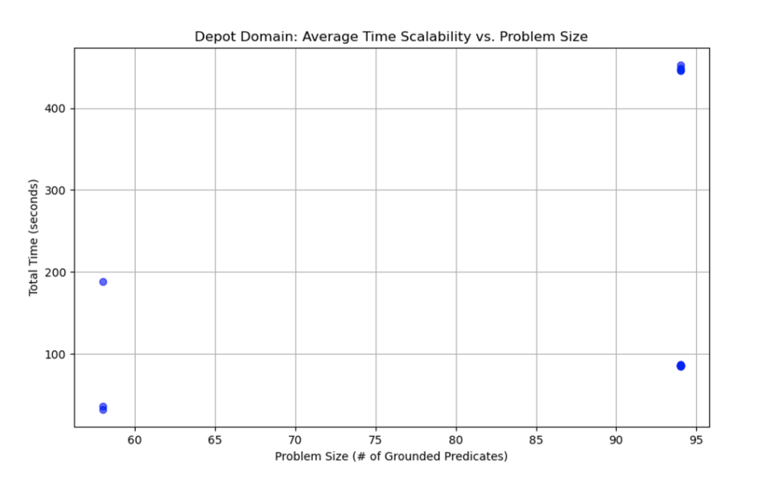
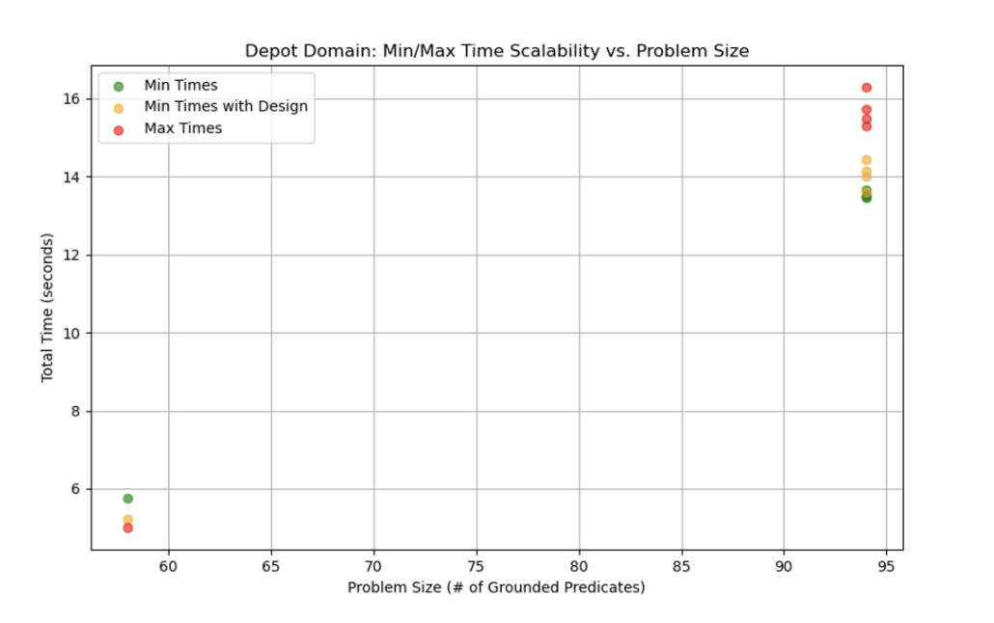
Effect of Problem Size on Time

Slide 108
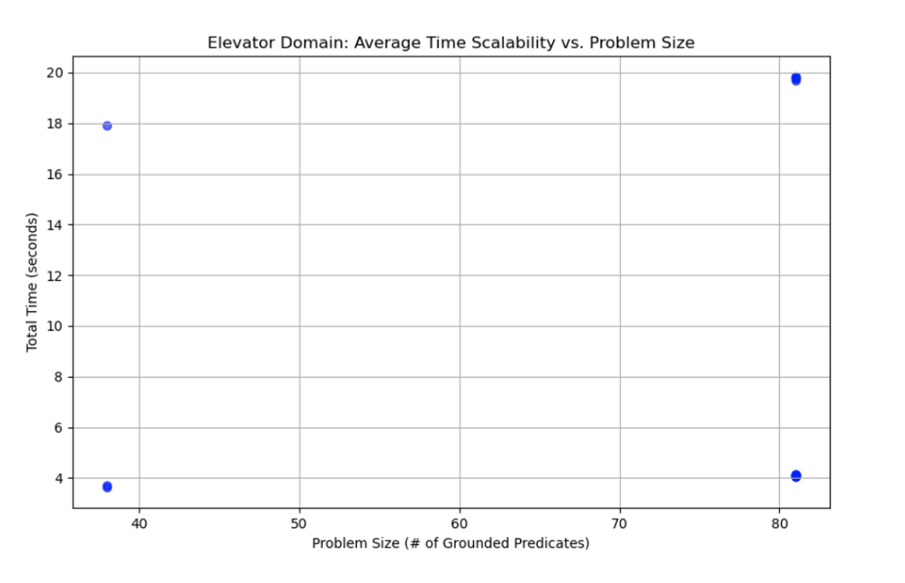
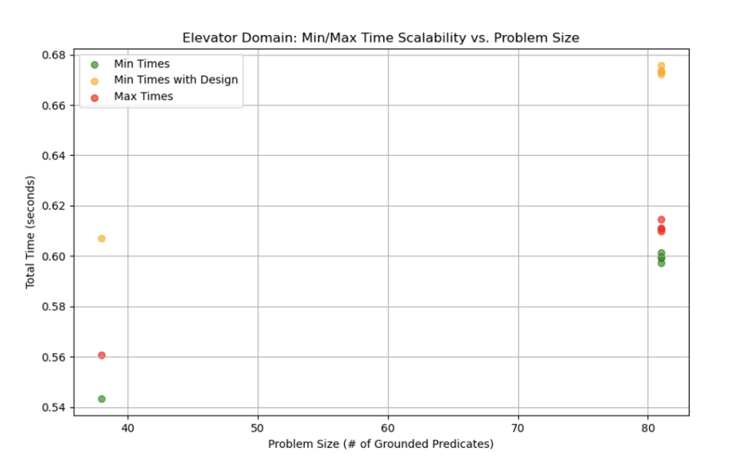
Effect of Problem Size on Time

Slide 109
Effect of Design Size on Best GSD Found
Explored how best-case Max/Min GD evolved with larger budgets
Created problems which allowed the addition/removal of initial state fluents & checked if solvable
Tested Elevator Domain
3 copies per instance
Slowly increased domain modifications from 1 to 5
Noted best average min/max divergence found within that budget
Increasing the budget resulted in lower max/min divergence; able to achieve zero in one problem instance

Slide 110
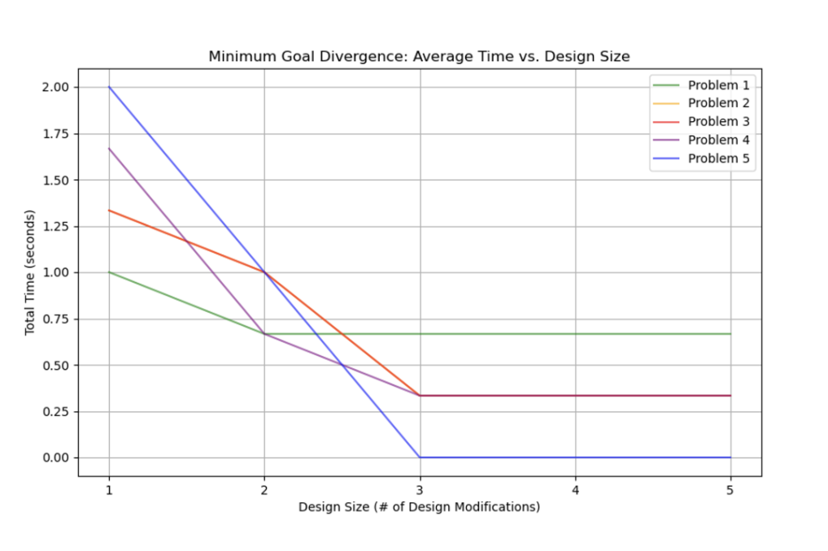
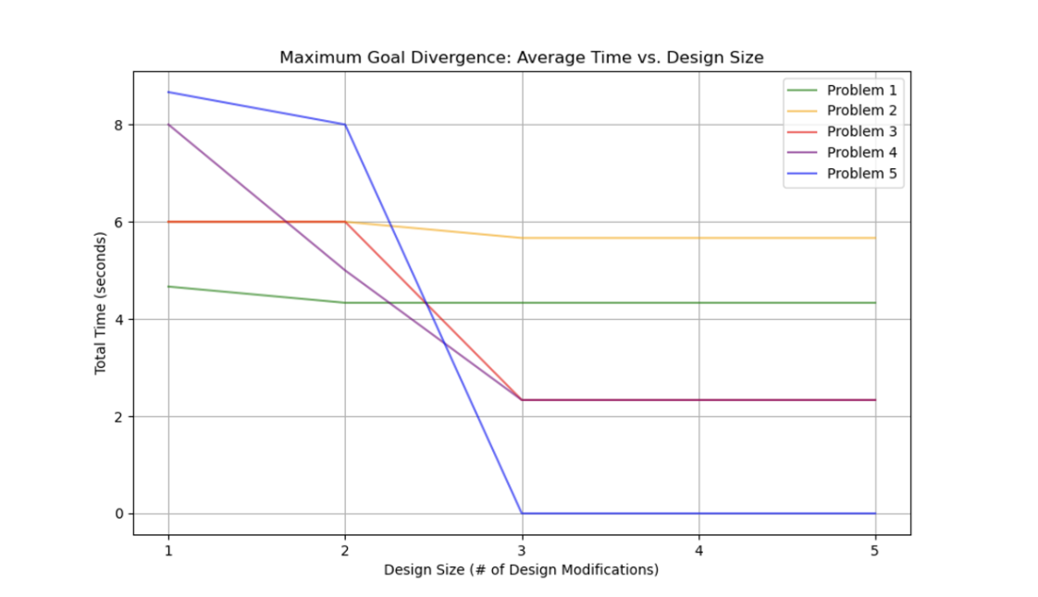
Effect of Design Size on Best GSD Found

